Slide 1
MIKE 11
Calibration and Data Needs

Slide 2
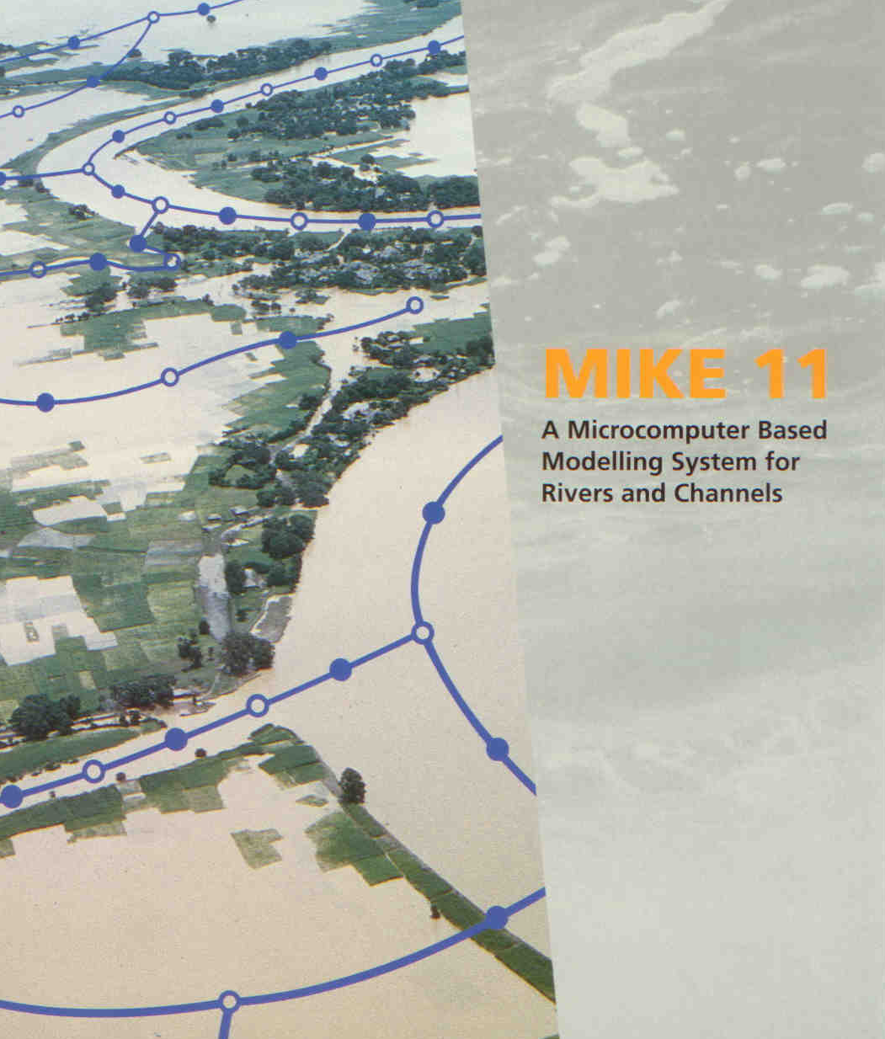
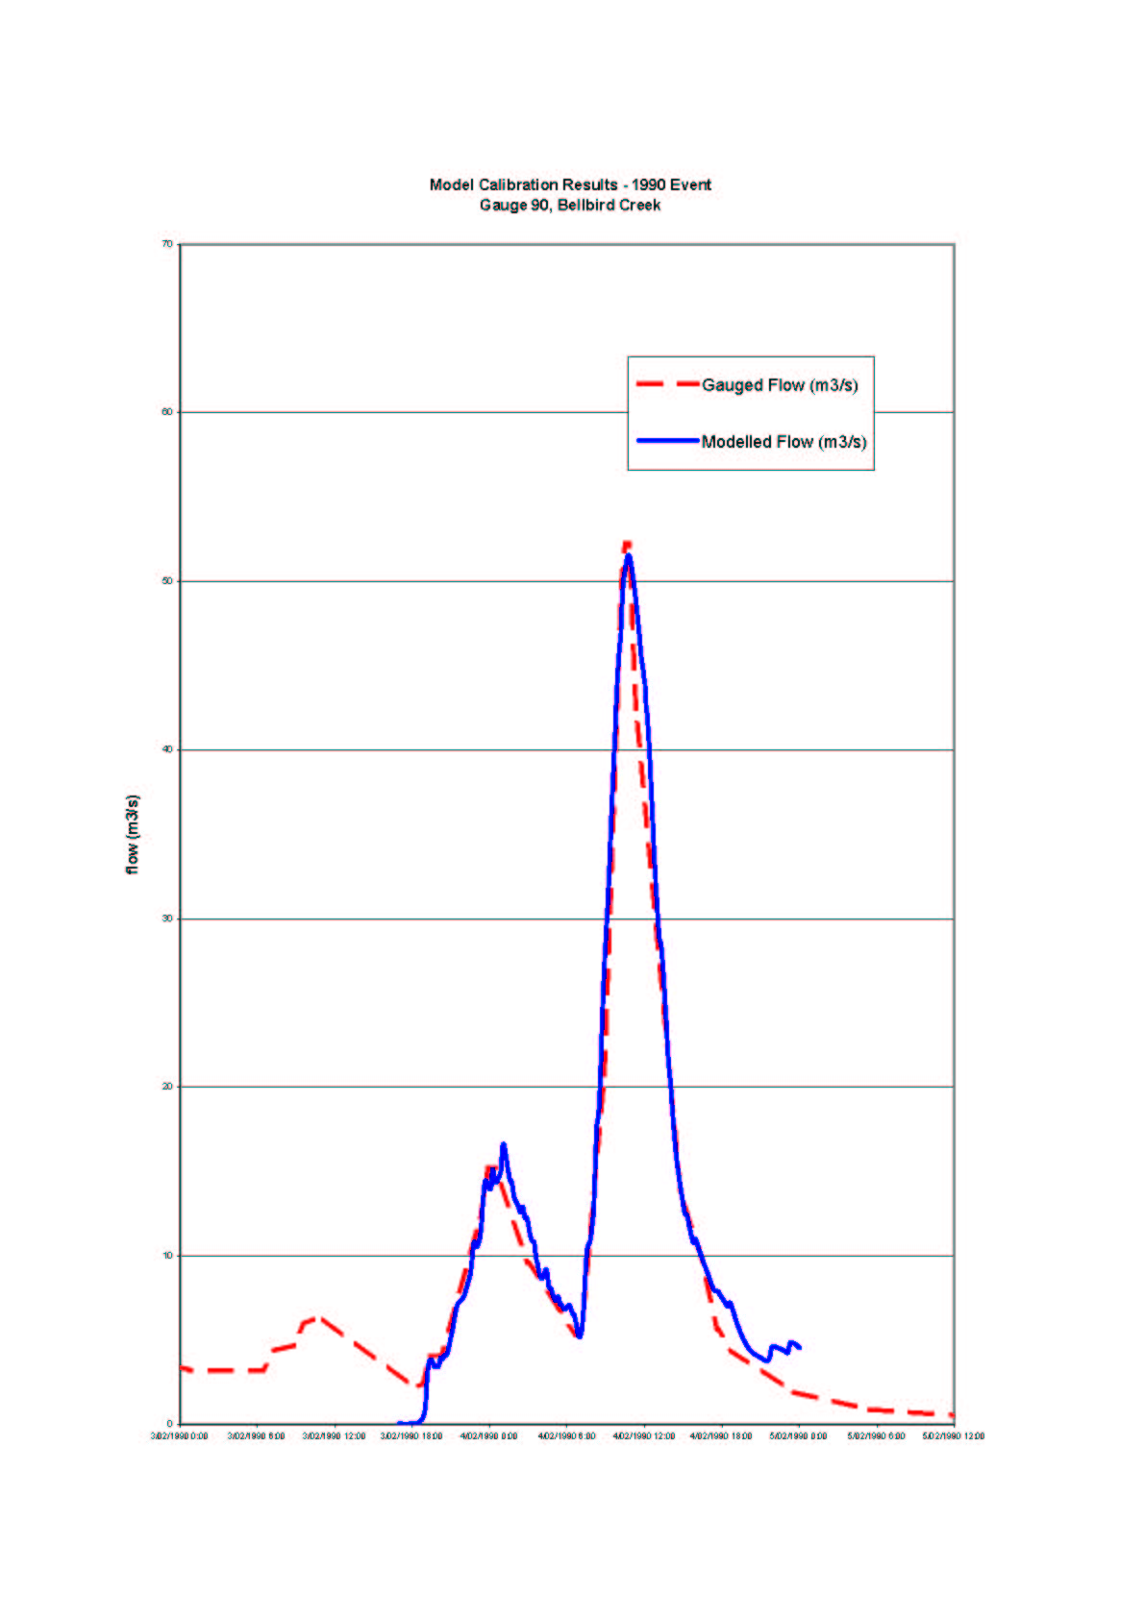
CALIBRATION AND DATA NEEDS
MIKE 11 Calibration, Verification and Data Needs

Slide 3
CALIBRATION AND DATA NEEDS
Model Data Requirements
Solution of Governing Flow Equations
Requires Detailed Descriptions of:
Catchment Delineation
River and Floodplain Topography
Hydrometric Data for Boundary Conditions
Hydrometric Data for Calibration / Validation
Man-made Interventions (Structures)
Q
Q
Q
h or Q/h

Slide 4
CALIBRATION AND DATA NEEDS
Model Data Requirements
Reliable Data Required: ‘GARBAGE IN = GARBAGE OUT’
Topographic Data: Logical Schematisation of Model
Survey of Cross-sections and Structures
Aerial/Satellite/Radar images of flood extents
Width, Area, Volume of inundated floodplains
Reservoir data (control strategy, spillway etc.)
DATUM - Same reference level for all data!
Hydraulic Data: Stage & Discharge Hydrographs
(used for boundary Rating Curves and Velocity Data
conditions and Peak Water levels during significant events
calibration of model) Anecdotal Flow Behaviour (direction, breakouts)

Slide 5
CALIBRATION AND DATA NEEDS
Model Calibration (Accuracy of Measured Data)
A Number of Factors can affect
the Accuracy of Measured Data:
Datum
Single Global Datum Required
Depth ‘vs’ Level Measurements
Marks on Objects that Move
(ie trees)
Timing
Daylight saving
Time of Peak rarely recorded
Location
Development (filling) in the floodplain
Structural upgrades since records
collected
Land-use changes affecting inflows
Wind and Debris
Wind effects
Blockages caused by Debris

Slide 6
CALIBRATION AND DATA NEEDS
Model Calibration (Water Balance)
Before Modifying Model Parameters to Match Levels, make sure the Water Balance is Correct:
Runoff from catchments
Inflows from tributaries not explicitly modelled
Industrial outlets and dam releases
Initial conditions in the floodplain
Tidal flows from the ocean

Slide 7
CALIBRATION AND DATA NEEDS
Model Calibration (Storage Volume)
It is important to get the Storage Volumes in the Model Correct:
Reservoir volumes
(particularly above the spillway level)
Additional storage in tributaries/areas
not explicitly modelled
Floodplains and secondary flow paths
Variations in cross-sectional width
Reach lengths (channel meander)

Slide 8
CALIBRATION AND DATA NEEDS
Model Calibration (Methods)
Adjustment of Model Parameters to Obtain Coincidence between Simulated and Measured Values:
1. Timing of Peak
- Reach lengths correct
- Resistance in the channel
- Hydrologic inputs
2. Value of Peak
- Resistance in the floodplain
- Storage in the model
- Link channels
- Structures defined properly
3. Shape of Hydrograph
- Variation of resistance with depth
- Model schematisation
- Hydrologic inputs
4. Volume of Hydrograph
- Storage in the model
- Resistance in the floodplain
- Hydrologic inputs

Slide 9
CALIBRATION AND DATA NEEDS
Model Calibration (Resistance)
Main Calibration Parameter is Resistance (Roughness)
Various Options for Modifying
Resistance in MIKE11:
Transversal and Depth Varying
Longitudinal Variation
Temporal Variation
Defined in the Tabular Sections
of the Cross-Section Database
Defined in the HD Parameter File
Defined as a Time Series and
Applied in the Boundary Editor

Slide 10
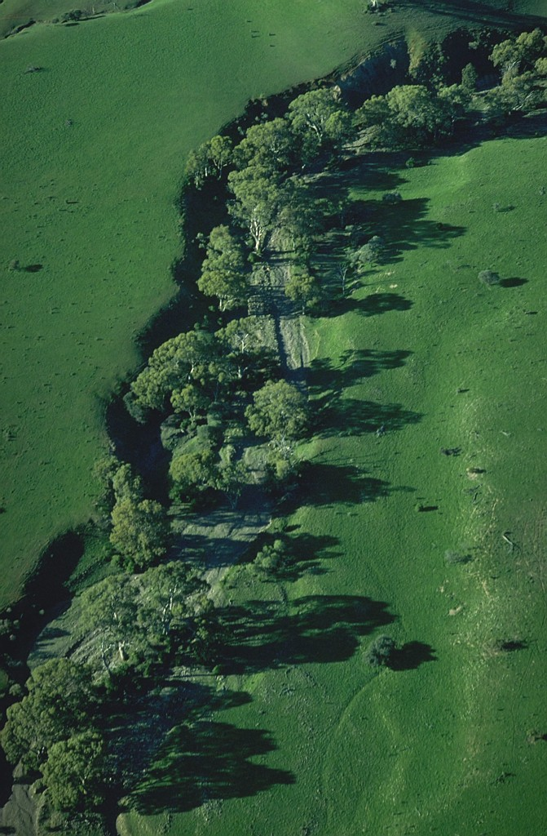
CALIBRATION AND DATA NEEDS
Roughness (Transversal/Depth Variation)
Applied in the Tabular Sections of the
Cross-Section Database either as
a Value or a Factor:
1. Transversal
- Assigned in Raw Data Section
- Value or Factor, Different Formulations
- Factor applied to value in HD Parameter File
- Selection based on X-Position in Section
2. Depth Varying
- Assigned in the Processed Data Section
- Factor only, applied to value in
HD Parameter File in the model
- Selection based on Level in the Section

Slide 11
CALIBRATION AND DATA NEEDS
Roughness (Longitudinal Variation)
Global and Local Values Applied in the HD Parameter File
M = 30
Global Value
+
Local Values
(overwrites Global
values at defined
locations)
Resulting bed resistance
M = 30
M = 25
M = 20
Manning’s M
M = 30
M = 25
M = 20
0.0 5000 10000 15000 20000 Distance [m]

Slide 12

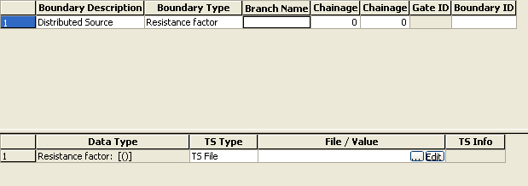
CALIBRATION AND DATA NEEDS
Roughness (Seasonal Variation)
Time Dependent Resistance Factor:
Specified in the Boundary Editor as a
Distributed Source (refers to DFS0 file)
Defined by Reach (local values cannot be applied)
Designed for long simulations (years)

Slide 13
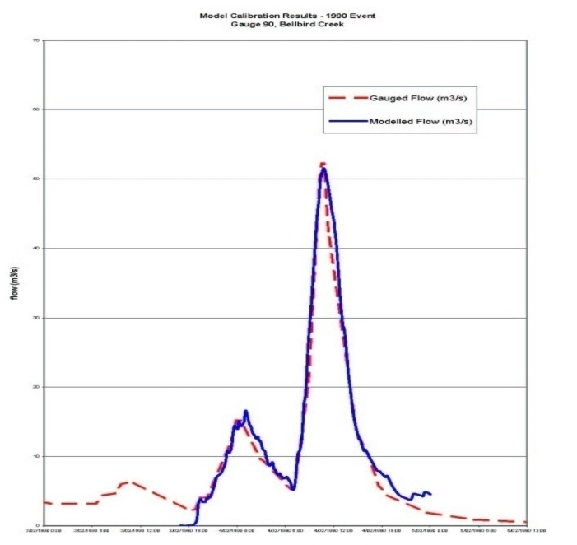
CALIBRATION AND DATA NEEDS
Verification and Model Accuracy
Need to Verify Model’s Performance – VERY IMPORTANT!
If possible, choose two sets of historical events (Calibration and Verification) covering a range of flow magnitudes. Test the calibrated model parameters for performance against Verification Data Set
Model Accuracy:
Each Case/Model is Unique
Depends on Budget and Time Constraints
Quality of Data in an Important Consideration
No Quantitative Criterion can be given
(however, when reporting levels use 2 decimal places)

